Slide 1
Graph Databases
July 2019
Pawel Maslej
pawel.maslej@lhasalimited.org

Slide 2
What is NoSQL?
It is schema free database. There is no need to define anything up-front by default
There are different kinds of types, these are tailored to specific purposes. Most popular are:
Key-value
Document
Graph
BigTable

Slide 3
Why NoSQL databases?
These type of databases are designed to grow horizontally and are more friendly fit for Cloud. There is large choice of different databases for different purposes
http://nosql-database.org/
To allow bringing in and use of semi- and unstructured data
To make it easier to adapt changing requirements and new features

Slide 4
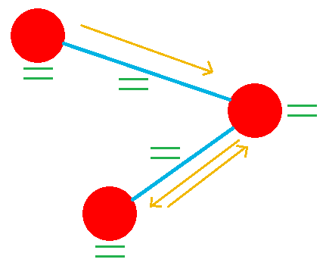
What is graph database?
It stores data in graph form
Key elements:
Vertex
Edge (optional)
Edge direction (in, out, both)
Property (optional,
vertex and edge)

Slide 5
Advantages of graph versus relational database (1)
Data for vertex and edge does not require full pre-defining
It can grow and change over time
Changing data structure does not require complex schema manipulations by default. Adding is handled automatically. Most of changes can be applied at Java level
Adding/removing/updating edges do not require to modify code at persistance layer (there aren’t any binded entities or foreign key rules by default)

Slide 6
Advantages of graph versus relational database (2)
Edges are individual links between vertices, they’re significantly faster to traverse through than using relational database queries where JOIN operation is used
Fast start to use graph database at simplest level
Persistance can be handled a bit later in project when conditions are understood better allowing database to be more tailored to business needs
Graph database scales better as more data is added in

Slide 7
Disadvanteges of graph versus relational database
Relational databases are more mature and understood
Schema provides strong validation of data structure
Better ACID support (atomicity, consistency, isolation, durability)
If data does not change, up-front effort with relational database may pay off later
It is hard to understand data that’s already inside graph database as schema is not present. This may be addressed by individual providers but in different ways too
Frameworks like Hibernate, SpringData provide more functionality and cover than TinkerPop

Slide 8
Graph databases API (1)
Many graph databases have common API to work with: Apache TinkerPop
http://tinkerpop.apache.org/
Not all graph databases implement it in same way or support all methods
Different vendors work with different library version, usually it is v3
For some of graph database providers, TinkerPop is native language to interact with their db
TinkerPop can be executed directly on database engine, and through Java API or any other supported language

Slide 9
Graph databases API (2)
TinkerPop main access is Traversal API.
This generates commands route that is submitted to DB engine and is processed by it. Some simpler methods can be executed without Traversal API, but these are not always supported and may be less efficient on remote access
Complex fetching always requires use of Travelsal API
Vertex can be given a label (equivalent to table name) so search can be narrowed and expected properties organised

Slide 10
Demo project
TinkerPop in practice (with OrientDB)
Recipes:
https://kelvinlawrence.net/book/Gremlin-Graph-Guide.html
http://tinkerpop.apache.org/docs/current/recipes/
Code (and slides):
https://github.com/dijef/graph-database-demo

Slide 11
My experience with graph database using OrientDB (1)
Threading access requires work to avoid issues
Orient supports transactions which is not common for many graph database vendors, these require manual care
Orient supports schema
Schema can be specified to constrain data being added in
Schema can be specified to do some optimisations: indexing, inheritance and so
Server mode provides web studio
http://localhost:2480/studio/index.html
Supports Orient SQL: select from v

Slide 12
My own experience with graph database using OrientDB (2)
OrientDB allows to execute native SQL and document functionality (like import from JSON)
Implementation of TinkerPop varies between different providers; e.g. Amazon only accepts traversal API, while OrientDB have some optimisations for direct methods and supports them in remote mode
OrientDB got extra things on the top of TinkerPop. So schema can be defined up-front to place indices, specify inheritance, etc.. It has its own optimisations and limitations and exuction behaviour becomes OrientDB specific to some level

Slide 13
My own experience with graph database using OrientDB (2)
Because of Travelsal API flexibility and high number of choices, there are many ways to perform same persistance operation. Therefore persistence access code need to be maintained to keep performance up while application is growing

Slide 14
OrientDB performance (early Axiom adoption)
Embedded
 | First | Second | Third time
Import 15k structures | 3186ms | 2635ms | 2623ms
Read all structures | 380ms | 504ms | 651ms
Search structures (indexed) match no match | 0-8ms (1) 73ms | 0-1ms (2) 0ms | 0-1ms (3) 0ms
Search structures (unindexed) match no match | 4-27ms (1) 0ms | 6-18ms (2) 0ms | 6-18ms (3) 0ms
Create 1000 projects | 3280ms | 2076ms | 1925ms
Remote access (other machine, cloud) is significantly slower, nearly as 100x (* when all calls are separate)

Slide 15
Questions?

